Slide 1
CS35L Software Construction Laboratory Lab 1: Nandan Parikh Week 9; Lecture 1

Slide 2
Software development process
●
Involves making a lot of changes to code
New features added Bugs fixed
Performance enhancements
–
–
–
●
Software team has many people working on the same/different parts of code
Many versions of software released
●
–
Ubuntu 10, Ubuntu 12, etc
Need to be able to fix bugs for Ubuntu 10 for customers using it, even though you have shipped Ubuntu 12.
–

Slide 3
Source/Version Control
●
Track changes to code and other files related to the software
–
What new files were added? What changes made to files?
Which version had what changes? Which user made the changes?
–
–
–
●
Track entire history of the software Version control software
●
–
GIT, Subversion, Perforce

Slide 4
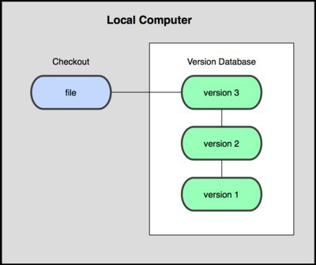
Local VCS
●
Organize different versions as folders on the local machine
No server involved
Other users should copy it via disk/network
●
●
Image Source: git-scm.com

Slide 5
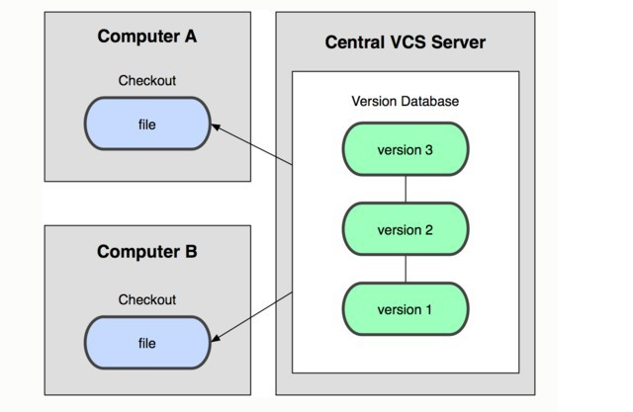
Centralized VCS
●
Version history sits on a central server
Users will get a working copy of the files
Changes have to be committed to the server
All users can get the changes
●
●
●
Image Source: git-scm.com

Slide 6
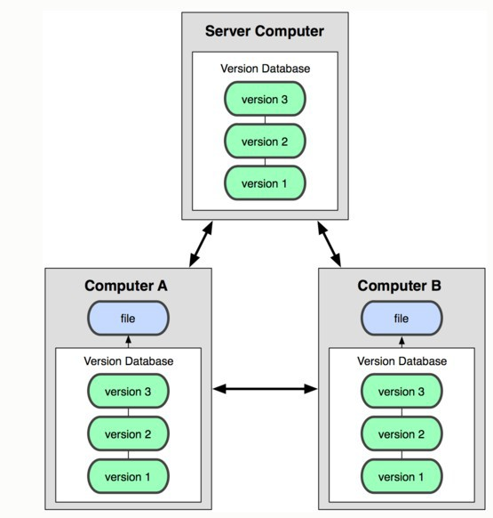
Distributed VCS
Version history is replicated at every user's machine
Users have version control all the time
Changes can be communicated between users
Git is distributed
●
●
●
●
Image Source: git-scm.com

Slide 7
GIT Source control

Slide 8

Git States
Index(cache)
git checkout
git add
git commit
Image Source: git-scm.com
Notes:
Committed means that the data is safely stored in your local database.
Modified means that you have changed the file but have not committed it to your database yet.
Staged means that you have marked a modified file in its current version to go into your next commit snapshot.

Slide 9
First Git Repository
$ mkdir gittest
$ cd gittest
$ git init
creates an empty git repo (.git directory with all necessary subdirectories)
$ echo “Boring world” > hello.txt
$ git add .
Adds content to the index
Must be run prior to a commit
$ git commit –m “Check in number 1”

Slide 11
Git commands
●
Repository creation
–
$ git init
$ git clone
(Start a new repository)
(Create a copy of an exisiting repository)
–
●
Branching
–
$ git branch <new_branch_name>
$ git checkout <tag/commit> -b <new_branch_name> (creates a new branch)
●
Commits
–
$ git add
$ git commit
(Stage modified/new files)
(check-in the changes to the repository)
–
●
Getting info
–
$ git status
$ git diff
$ git log
$ git show
(Shows modified files, new files, etc) (compares working copy with staged files) (Shows history of commits)
(Show a certain object in the repository)
–
–
–
●
Getting help
–
$ git help

Slide 12
Working With Git
$ echo “I love CS35L !!” >> hello.txt
$ git status
Shows list of modified files
hello.txt
$ git diff
Shows changes we made compared to index
$ git add hello.txt
$ git diff
No changes shown as diff compares to the index
$ git diff HEAD
Now we can see changes in working version
$ git commit –m “Second commit”

Slide 13
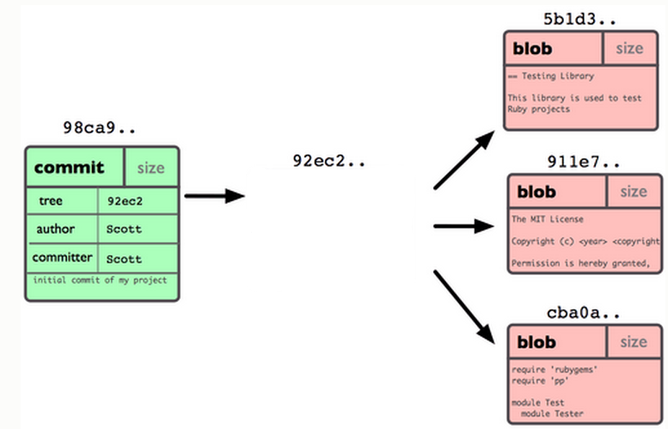
Git Repo Structure
Snapshot
tree |  | size
blob | 5b1d3 | README
blob | 911e7 | pacman.c
blob | cba0a | pacman.h

Slide 14
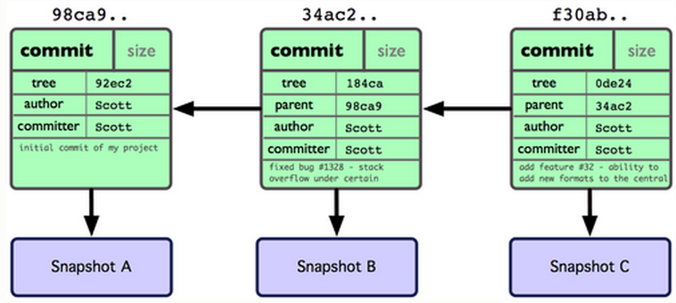
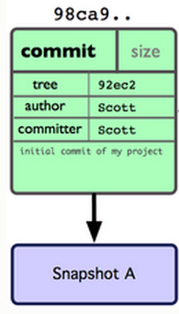
After 2 More Commits…

Slide 15
What Is a Branch?
A pointer to one of the commits in the repo (head) + all ancestor commits
When you first create a repo, are there any branches?
Default branch named ‘master’
The default master branch
points to last commit made
moves forward automatically, every time you commit

Slide 16
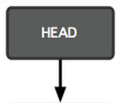
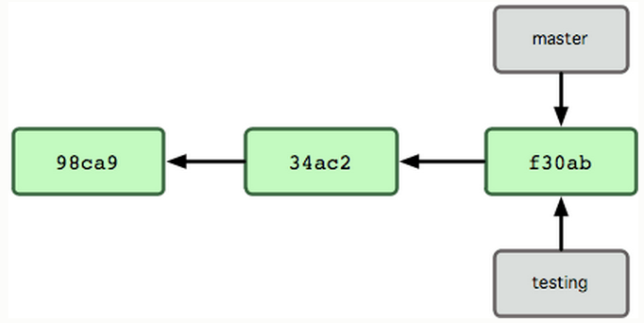
New Branch
Creating a new branch = creating new pointer
$ git branch testing
Where is new branch created?
Current commit
Where is current commit?
HEAD

Slide 17
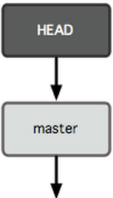
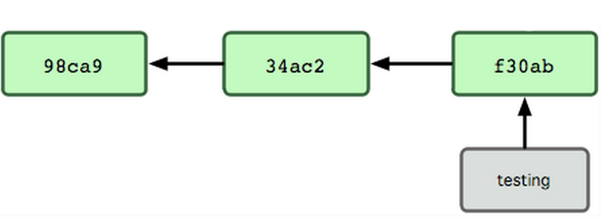
New Commit
What happens if we make another commit?
345f5

Slide 18
Switching to New Branch
Check out new branch
$ git checkout <branch_name>
$ git checkout testing

Slide 19
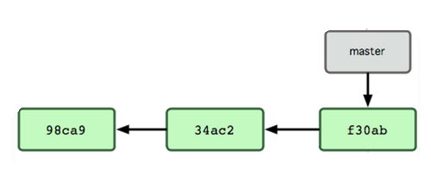

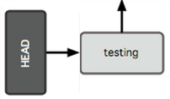
Commit After Switch

Slide 20
Why Branching?
Experiment with code without affecting main branch
Separate projects that once had a common code base
2 versions of the project

Slide 21
Working With Branches
$ git branch test
Create new branch
$ git branch
Lists all branches
$ git checkout test
Switch to test branch
$ echo “hello world!” > hw
$ Commit the change in new branch
$ git checkout master
Back to master branch
$ git log
$ git merge test
Merges commits from test branch to current branch(here master)

Slide 22
Git integrating changes
Required when there are changes in multiple branches
Two main ways to integrate changes from one branch to another : merge and rebase
Merge is simple and straightforward
Rebase is much cleaner

Slide 23
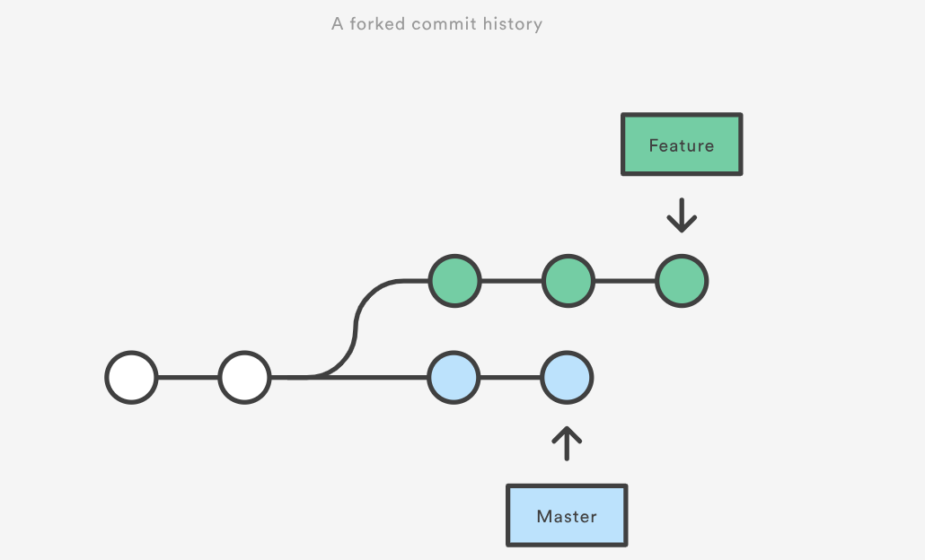
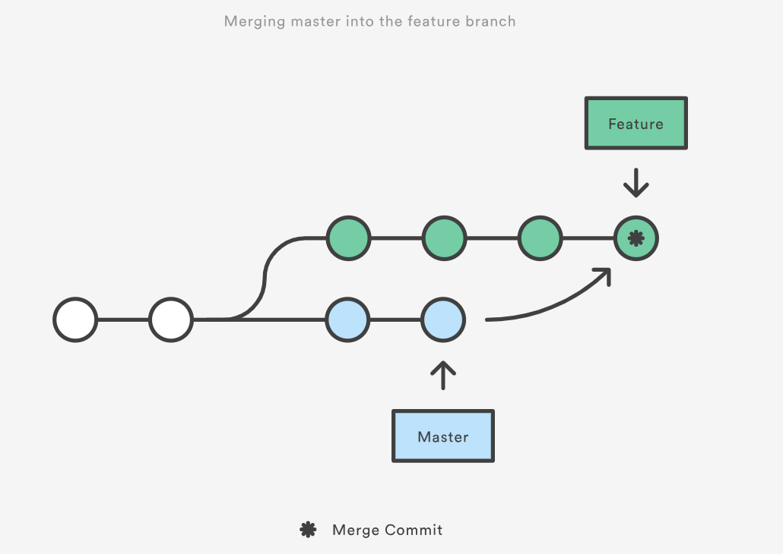
Git merge
Source : https://www.atlassian.com/git/tutorials/merging-vs-rebasing

Slide 24
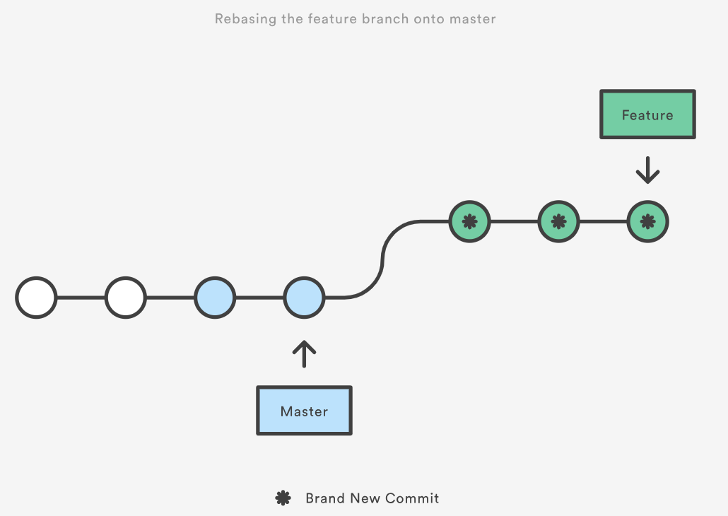
Git rebase
Source : https://www.atlassian.com/git/tutorials/merging-vs-rebasing

Slide 25
Merge Conflicts
Usually git will do merge automatically
Conflict arises when you changed the same part of the same file differently in the two branches you’re merging together
The new commit object will not be created
You need to resolve conflicts manually by selecting which parts of the file you want to keep

Slide 26
More Git Commands
●
Reverting
–
$ git checkout HEAD main.cpp
●
Gets the HEAD revision for the working copy
–
$ git checkout -- main.cpp
●
Reverts changes in the working directory
–
$ git revert
●
Reverting commits (this creates new commits)
●
Cleaning up untracked files
–
$ git clean
●
Tagging
–
Human readable pointers to specific commits $ git tag -a v1.0 –m 'Version 1.0'
–
●
This will name the HEAD commit as v1.0

Slide 27
Lab 9
Fix an issue with diff diagnostic - apply a patch to a previous version
Installing Git
SEASnet
Git is installed in /usr/local/cs/bin
Add it to PATH variable or use whole path
$ export PATH=/usr/local/cs/bin:$PATH
Make a directory ‘gitroot’ and get a copy of the Diffutils Git repository
$ mkdir gitroot
$ cd gitroot
$ git clone <URL>
Follow steps in lab and use man git to find commands

Slide 28
Hints
git clone
git log
git tag
git show <hash>
git checkout v3.0 –b <branchname>

Slide 29
Homework 9
Publish patch you made in lab 9
Create a new branch “quote” of version 3.0
Branch command + checkout command (git branch quote v3.0; git checkout quote)
$ git checkout v3.0 -b quote
Use patch from lab 9 to modify this branch
Patch command
$ patch –pnum < quote-3.0-patch.txt
Modify ChangeLog file in diffutils directory
Add entry for your changes similar to entries in ChangeLog
Commit changes to the new branch
$ git add . $ git commit –F <Changelog file>
Generate a patch that other people can use to get your changes
$ git format-patch -[num] --stdout > formatted-patch.txt
Test your partner’s patch
Check out version 3.0 into a temporary branch partner
Apply patch with git am command: $ git am < formatted-patch.txt
Build and test with $ make check
Make sure partner’s name is in HW9.txt

Slide 30
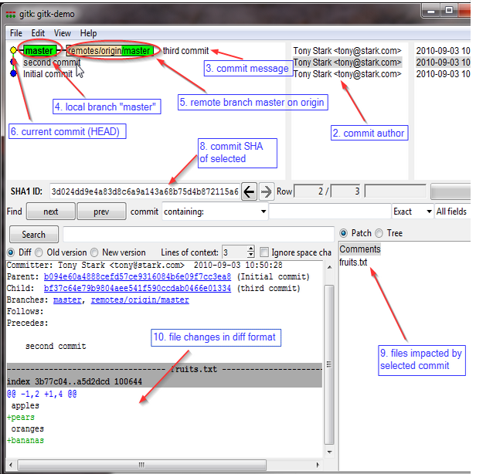
Gitk
A repository browser
Visualizes commit graphs
Used to understand the structure of the repo
Tutorial: http://lostechies.com/joshuaflanagan/2010/09/03/use-gitk-to-understand-git/

Slide 31
Gitk
SSH into the server with X11 enabled
ssh -X for OS with terminal (OS X, Linux)
Select “X11” option if using putty (Windows)
Run gitk in the ~eggert/src/gnu/emacs directory
Need to first update your PATH
$ export PATH=/usr/local/cs/bin:$PATH
Run X locally before running gitk
Xming on Windows, Xquartz on Mac

